Slide 1

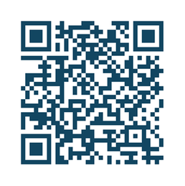

Join Me at the NCS 24th Annual Meeting
•The NCS Annual Meeting offers a diverse range of educational sessions, workshops and interactive discussions aimed at enhancing your skills and knowledge in neurocritical care
•Join over 1,000+ healthcare professionals in Seattle
•Opportunity to earn valuable continuing education credits
•Multidisciplinary sessions focusing on science, clinical practice and quality
Visit us in the Exhibit Hall at [BOOTH #]
Our booth features [INSERT DESCRIPTION]
24th Annual Meeting
October 20-23, 2026, Seattle, Washington
Seattle Convention Center

